Slide 1
Rubber Coating Wheel Pre-Maintenance of EMS Line
EMS输送线包胶轮 预测性维护
Nov., 2021

Slide 2
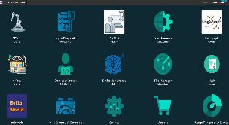
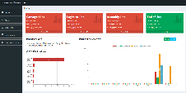
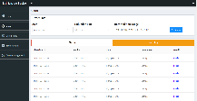



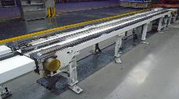
UseCase：Chain Conveyor Pre-Maintenance in FAW-VW 应用案例 ：底盘线PA链床预测性维护
Cloud Level
MindSphere Native Apps
Maintenance Service
1*
MindSphere
Cloud-based IoT Operating System
HTTPs
MQTT
Edge Level
MindConnect Nano
MindSphere Native Gateway
(transfer processed real-time data)
Advanced diagnosis algorithm
based on x-tools output
(transfer the alert alarm info)
OPC UA
Edge App
CMS2000
TCP
TCP
CMS2000
Siemens
Data Acquisition
IPC
Siemens
Data Acquisition
IPC MicroBox + X-tools*
Field Level
2 PCB
Vibration Sensor
2 PCB
Vibration Sensor
Chain Conveyor
TF3100
Chain Conveyor
TF3110
X-tools*: Siemens standard vibration analysis tool
Restricted | © Siemens 2021 | T RDA IOT INW-CN
Notes:
Sensor Info：
PCB
Measuring Range：50g；Frequency Range：0.33~10000Hz；Protection Class：IP67；Price：3000 CNY

Slide 3
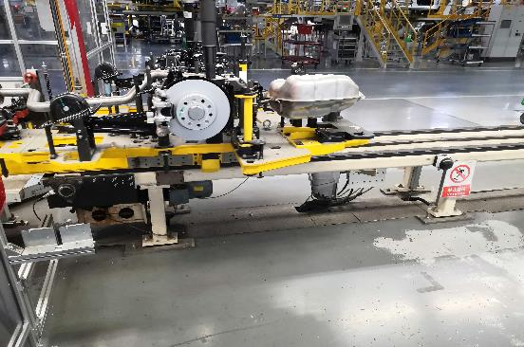
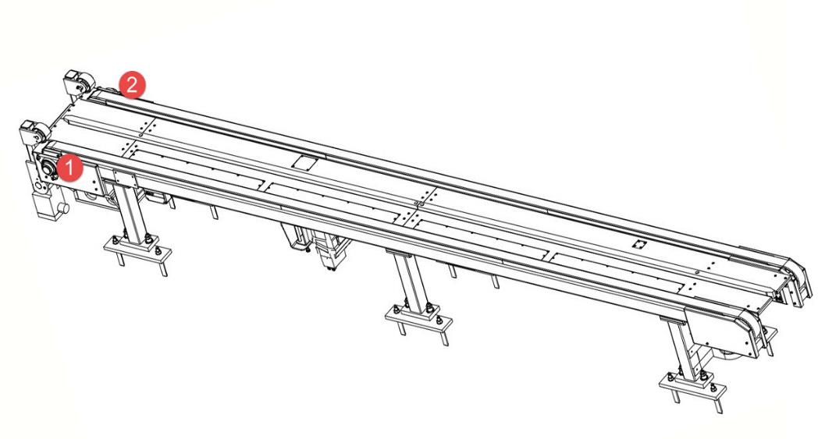
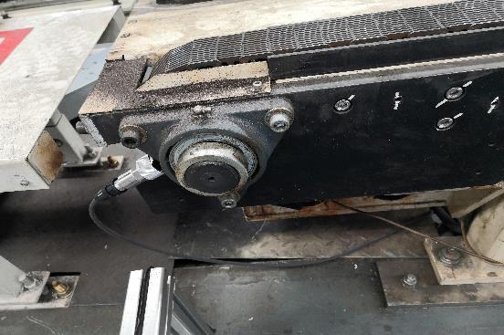
UseCase：Chain Conveyor Pre-Maintenance in FAW-VW 应用案例 ：底盘线PA链床预测性维护
On-Site sensors installation in Chain Conveyor
-Two sensors in one station
2个传感器/工位
- For bearing and chain vibration signals
主要监测轴承和链的振动
- Magnet adsorption installation (recommend rigid connection)
目前是采用磁吸的方式安装传感器，建议采用刚性连接
Restricted | © Siemens 2021 | T RDA IOT INW-CN

Slide 4
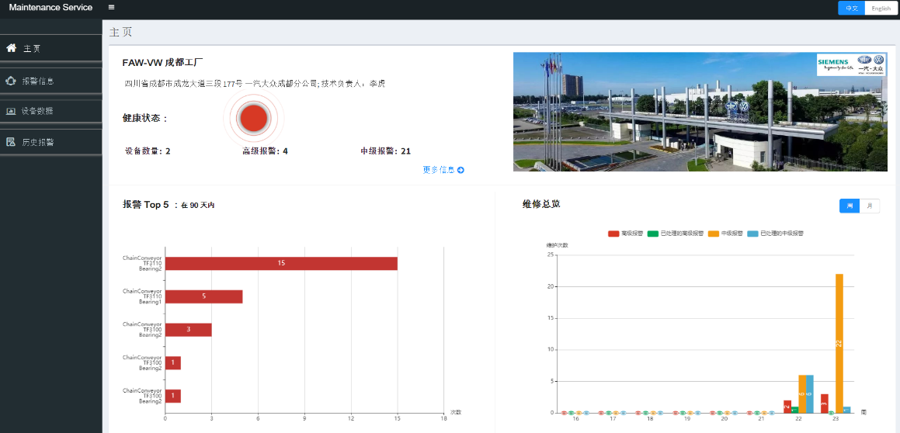

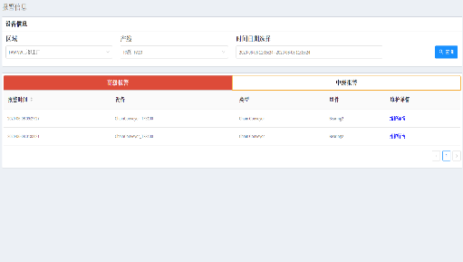
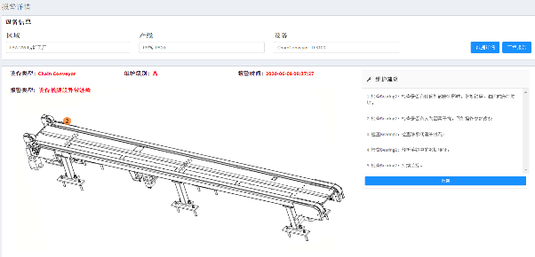
UseCase：Chain Conveyor Pre-Maintenance in FAW-VW 应用案例 ：底盘线PA链床预测性维护
SiMaint
Pre-Maintenance Service
预维护应用服务
Application was deployed in MindSphere
(also support local deployment)
Restricted | © Siemens 2021 | T RDA IOT INW-CN

Slide 5
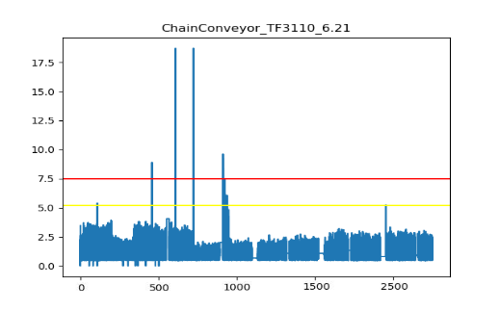
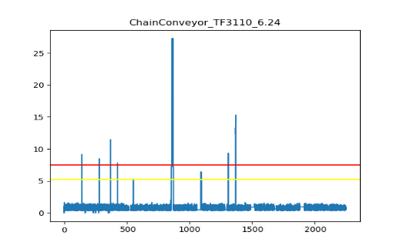
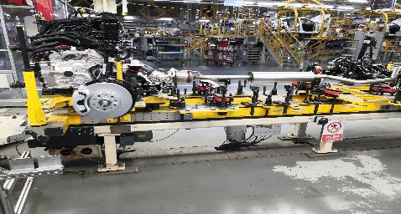
Successful Case
FAW-VW, Chengdu West
Plant | FAW-VW West
Device | Chain Conveyor
CarType | Sagitar/Jetta VA3
Cycle | 60 JPH
Data Characteristics
Fault Station：TF3110
Characteristics：The monitoring data value is abnormally high energy in short-time interval, higher than the algorithm threshold.
Feedback from engineer： After tightening the gun to jack up the prattle, the rear-axle pallet not return its original position automatically; when the prattle runs to this station, the rear- axle pallet returns back to position .
Impact Station：TF3110
Characteristics： The monitoring data value has multiple times burst abnormal energy, which is higher than the algorithm threshold
Feedback from engineer：Due to the chain was clipped by a screw.
TF3110
21th Jun, Rear-Axle Pallet Return
24th Jun, Chain Clipped because of screw
Data Source：vibration sensor，unit: g (g=9.8*m/s2)；
Data Segment：Fetch Data Points on 2020-06-21 and 2020-06-24

Slide 6
Rubber Coating Wheel Pre-Maintenance of EMS Line EMS输送线包胶轮 预测性维护

Slide 7
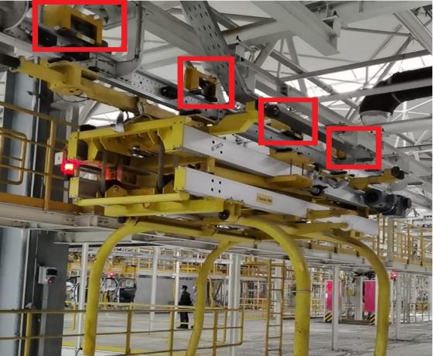
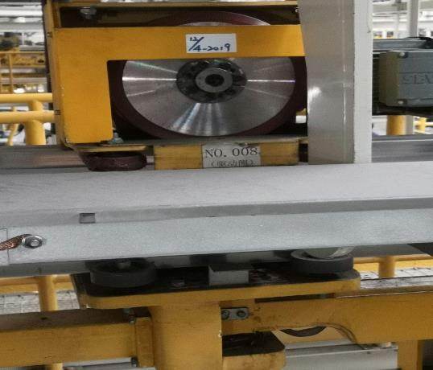
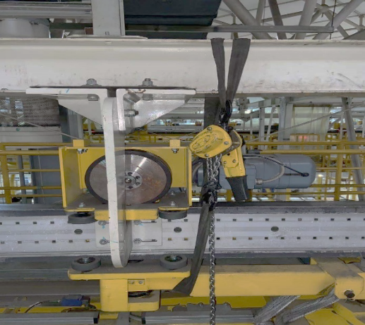
Summary of field investigation on rubber coating wheel EMS线包胶轮现场调研总结
Regular Inspection 正常巡检
Number of FAW-VW EMS Spreader ：110
现场EMS线，含有110架吊具
Number of Rubber Driving Wheel on each Spreader：4
每个吊具上有4个驱动包胶轮
Daily times of inspection：2
每天巡检2次
Time cost of inspection：1 hour
每次巡检消耗1小时
Rubber Coating Wheel Fault 包胶轮故障
Cost of Rubber Coating Wheel：2000（CNY）
国产包胶轮价格2000+ CNY
Times of unplanned shutdown：10 +/Year
每年的计划外停机次数：10次
Inspection Method for the fault：based-on rubber chip
检查故障的方式：巡检时查看橡胶碎块
General service life (based on experience):
2 +/- years
包胶轮的经验寿命：2 年左右，进行定时更换
Maintenance 维修
Maintenance time of fault：30~60 mins
维修时长一般是30~60分钟
Difficulty of maintenance： High altitude operation，so it is more difficult
高空作业维护，所以难度较高，特别是两端的驱动轮更难更换
Maintenance engineer requirements：need trained engineers, at least 3 engineers to maintenance
需要经过培训的工程师进行维修，且需要至少3人协同合作维修
Restricted | © Siemens 2021 | T RDA IOT INW-CN

Slide 8


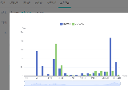
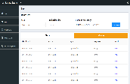

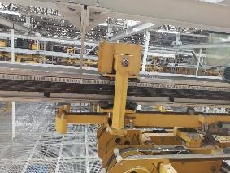
Solution of Rubber Coating Wheel Pre-Maintenance based on Vibration 基于振动的包胶轮预测维护方案
MaintLoop 边缘计算应用
Web Application
应用程序
SiMaint 应用
Data Base 数据库
Edge Computing
边缘算法
Local Server
服务器
Ethernet
PLC：1215C
Sampling Cycle:1s
- Vibration sensor * 2
on EMS track
在包胶轮轨道上安装2个振动传感器
DAQ：SM1281*1
在线边安装SM1281，
与传感器距离不超过20米
- Vertical and horizontal installation
分别采用垂直和水平的安装角度
- Monitoring position near to OP line
（no-load，uniform speed）need on-site test data to confirm
在OP线附近，寻找无负载、匀速的位置布设传感器进行信号采集(详细位置需根据现场数据进一步确认)
Restricted | © Siemens 2021 | T RDA IOT INW-CN

Slide 9
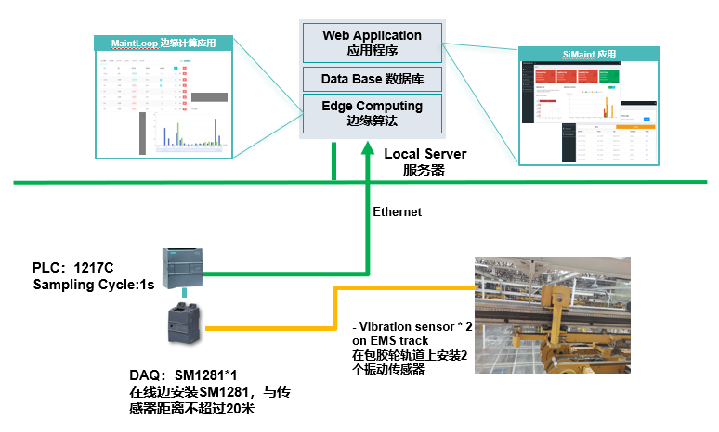
Solution of Rubber Coating Wheel Pre-Maintenance based on Vibration 基于振动的包胶轮预测维护方案
Hardware 硬件:
Vibration sensors and DAQ
振动传感器与数据采集硬件
Local Server
本地服务器硬件
K-Box and corresponding hardwares
K箱及相应配件和辅料
Software 软件:
Edge computing application MaintLoop
自研发边缘计算应用工具MaintLoop（不含源码）
Data Storage System
本地服务器存储系统
Pre-Maintenance application SiMaint
自研发预维护应用程序 SiMaint
（建议打通现场网络环境，对预警进行邮件通知服务）
Project Scope 项目范围:
Monitoring the vibration of EMS track, realize the real-time state monitoring of the rubber coating wheel and pre-maintenance.
通过监测包胶轮所在EMS车身线轨道的振动强度情况，实现对包胶轮的实时状态监控和预维护
Realize fault alarm and statistics by edge computing.
通过边缘计算算法，实现及时的故障报警和统计
Provide pre-maintenance app to customer
提供维护APP，实现预防性维护支持。
Deployment 部署:
Field implementation and commissioning of hardware and electrical
硬件与电气现场实施调试
Software integration commissioning
软件现场实施调试
Implement system maintenance and algorithm optimization 3 months after delivery
实施交付后3个月系统维护和算法优化
Documentation and Training
文档和培训
Restricted | © Siemens 2021 | T RDA IOT INW-CN

Slide 10
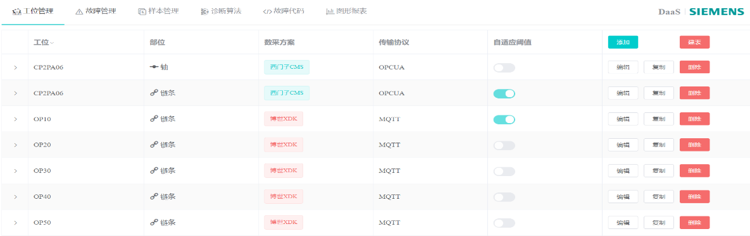

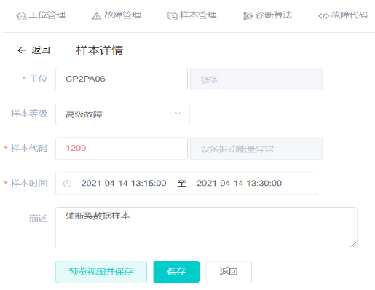
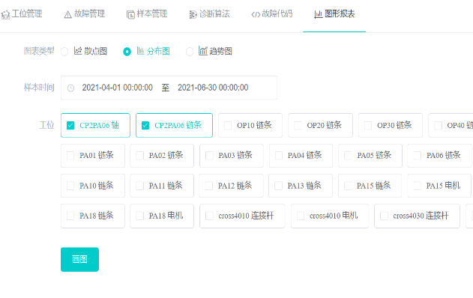
MaintLoop as the Edge Computing Application 提供基于MaintLoop的边缘计算应用程序
MaintLoop
Pre-Maintenance Edge Service
预维护边缘端应用服务
Support device and data management
Integrated edge computing algorithms
Guide maintenance engineer to label data sample
Data insight by statistic report charts
Restricted | © Siemens 2021 | T RDA IOT INW-CN

Slide 11
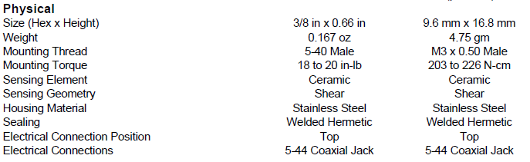
附：M621C40振动传感器
由于M621C40是IEPE型传感器，选用2芯线缆，一头直接接入采集卡SM1281；线缆另一头使用coaxial jack连接传感器。
连接传感器线缆接头
传感器
M621C40
固定传感器

Slide 12
Questions?
Answers!

Slide 13
Contact
Published by Siemens
T RDA IoT INW-CN
Expert
YU He
200, Linghu Avenue 214135, Wuxi China
Mobile: +86 18921506861
E-mail: yu-he@siemens.com

